Slide 1

Getting Pushy with SignalR and Rx
Jim Wooley
www.ThinqLinq.com
@jimwooley

Slide 2

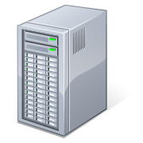
Problems with Pull - Web

Slide 3
Getting Pushy with SignalR
SignalR

Slide 4
SignalR for Server Push
Server
Asp.Net
Self-Host
Client
javaScript
.Net
Owin
WinRT
WebSocket
Long Polling
Heartbeat
Server sent events
Forever Frame

Slide 5
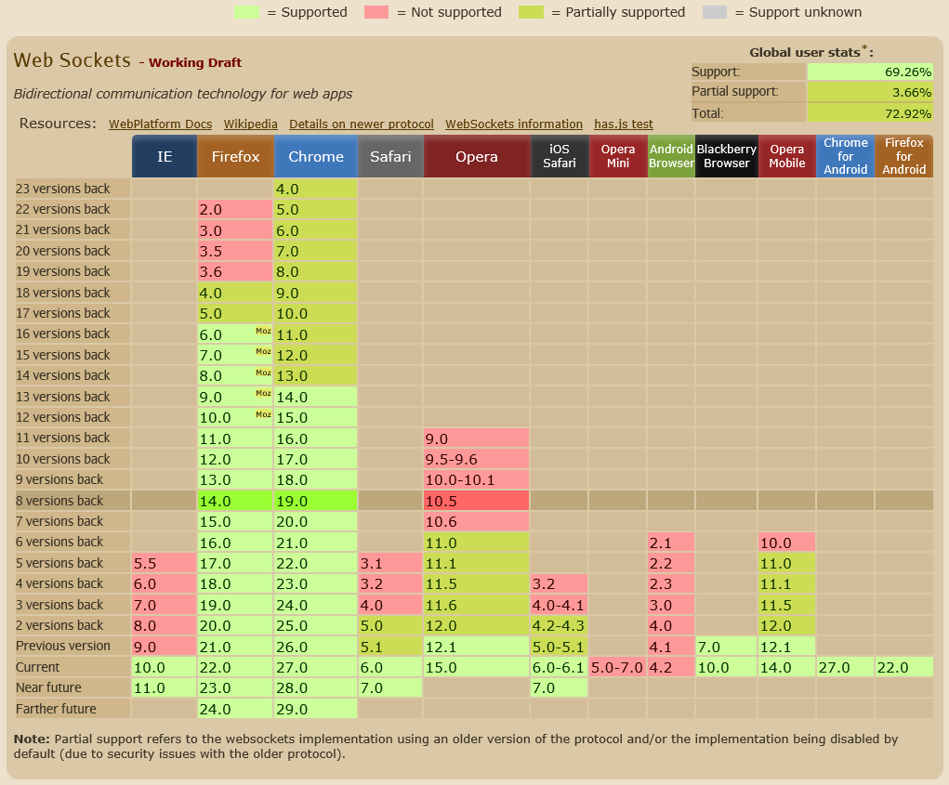
http://caniuse.com/websockets

Slide 6
SignalR Demo

Slide 7
Chat Server
Option Strict Off
Imports Microsoft.VisualBasic
Imports SignalR.Hubs
Public Class Chat
Inherits Hub
Public Sub Send(message As String)
Clients.All.addMessage(message)
End Sub
End Class

Slide 8
Chat Clients
// javascript
var chat = $.connection.chat;
chat.addMessage = function (message) { $('#messages').append('<li>' + message + '</li>');
};
$.connection.hub.start();
$("#broadcast").click(function () { chat.send($('#msg').val());});
// C#
cn = new HubConnection("http://localhost:5687/");
proxy = cn.CreateProxy(“chat");
proxy.On("AddMessage", message =>
Dispatcher.Invoke(new Action(() => chatItems.Add(message)))
);
cn.Start();
private async void BroadcastBtn_Click(object sender, RoutedEventArgs e)
{
await proxy.Invoke("Send", Input.Text);
}

Slide 9
SignalR core architecture: pub/sub
publisher
1. Message serialized, saved to cache associated with signal, topic is marked for delivery, publish call returns
message bus
message cache
3. Worker sends message to client as bytes over a transport
2. Worker is scheduled for a signal, selects a waiting subscriber, retrieves message from cache
worker
worker
worker
client
client
client
client
client

Slide 10
Scale-out provider architecture
backplane
Messages sharded over multiple backplane streams
protected void Application_Start(object sender, EventArgs e)
{
RouteTable.Routes.MapHubs();
GlobalHost.DependencyResolver.UseRedis(server,
port, password, "SignalR.Redis.Sample");
}
web nodes
clients

Slide 11
Getting Pushy with SignalR and Rx
SignalR
Rx
Rx

Slide 12

Problems with Pull - LINQ
public interface IEnumerator<T>
{
T Current { get; }
bool MoveNext();
void Reset();
}
public interface IObserver<T>
{
void OnCompleted();
void OnError(Exception exception);
void OnNext(T value);
}
Blocking

Slide 13
Reactive Framework
“Rx is a library for
composing asynchronous and
event-based programs using
observable collections.”

Slide 14
Rx Demo

Slide 15
Rx Push - Server
Dim rand = New Random(Now.Millisecond)
Dim Generator = Observable.Generate(Of Double, SensorData)(
initialState:=0,
condition:=Function(val) True,
iterate:=Function(val) rand.NextDouble,
resultSelector:=Function(val) New SensorData With
{.Time = Now, .Value = val * 20, .Category = (CInt(val * 4)).ToString() },
timeSelector:=Function(val) TimeSpan.FromSeconds(val))
Dim query = From val In Generator
Where val.Value > 10
Select val
query.Subscribe(Sub(value)
Dim context = GlobalHost.ConnectionManager.
GetHubContext(Of ObservableSensorHub)()
context.Clients.Broadcast(value)
End Sub)

Slide 16
RX Push - Client
Dim cn = New HubConnection("http://localhost:5687")
Dim sensor = cn.CreateProxy("observableSensorHub")
Dim items = From item In sensor.Observe("broadcast")
Let instance = item(0).ToObject(Of SensorData)()
Where instance.Category = "1"
Select instance
Using items.Subscribe(Sub(value) Console.WriteLine(value.Value))
cn.Start().Wait()
Console.ReadLine()
End Using

Slide 17
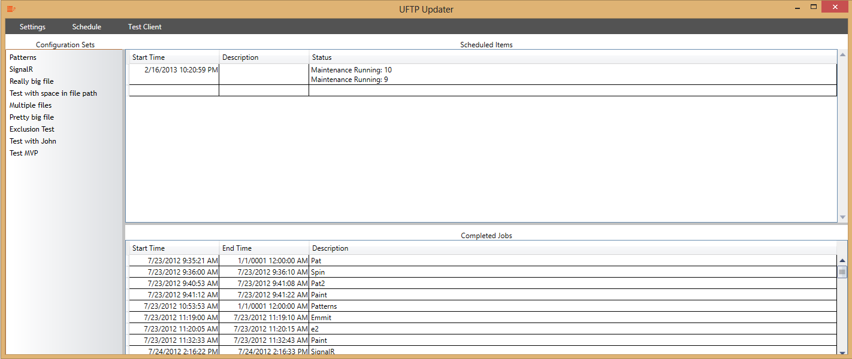
Demo – SignalR & RX

Slide 18


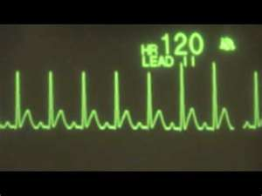


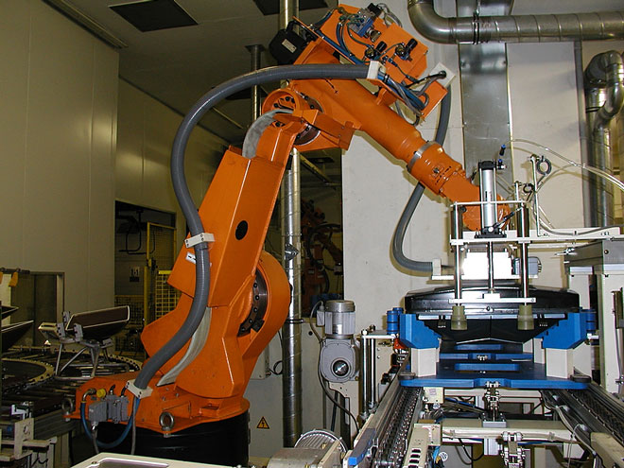

Common Uses

Slide 19
Resources
SignalR
RX
JabbR
ShootR
@DavidFowl
@DamienEdwards
Free Ebook
Team Blog
Source
Paper.li
@ReactiveX
Free Ebook

Slide 20
Questions
Jim Wooley
www.ThinqLinq.com
@jimwooley

